Slide 1
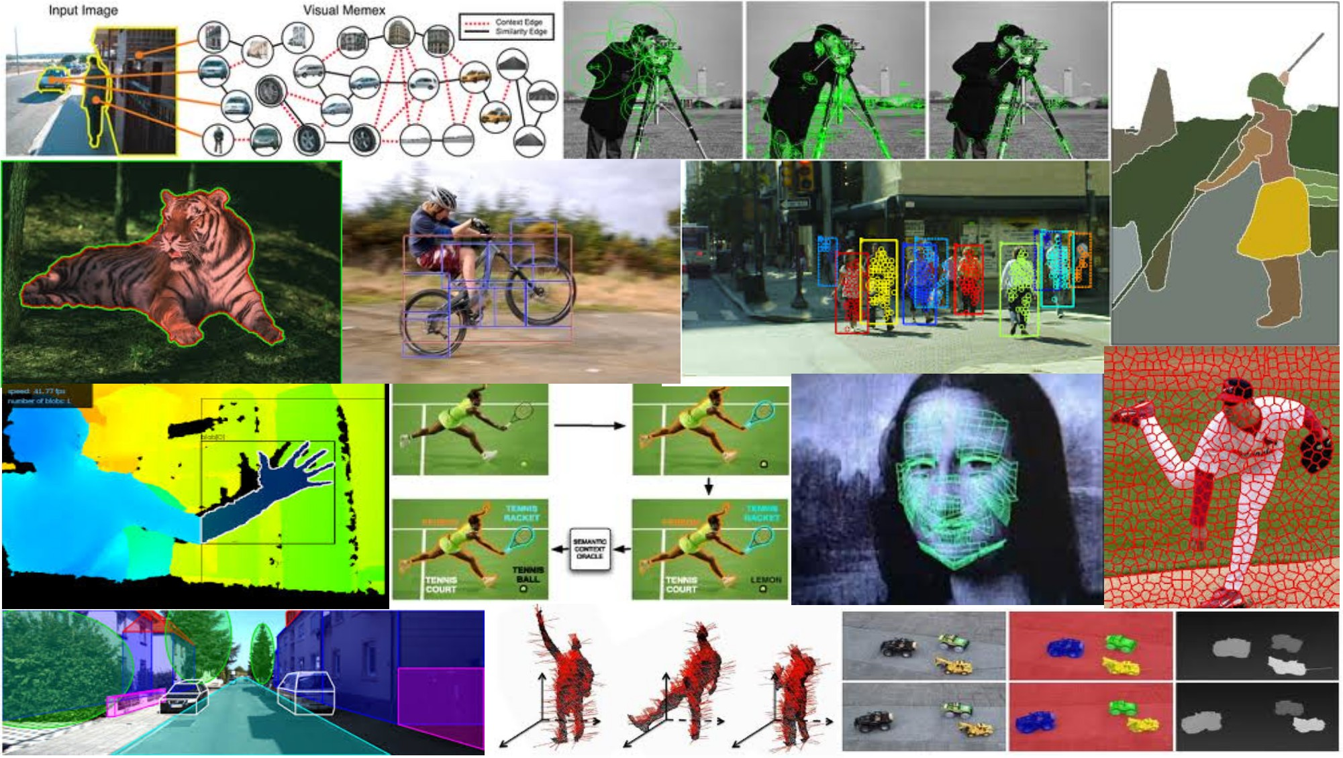
Deep Convolutional Neural Networks (DCNN or CNN)
Slides from Yong Jae Lee, Rob Fergus, Svetlana Lazebnik, Jia-Bin Huang

Slide 2
Overview
Background
Convolutional Neural Networks (CNNs)
Understanding and Visualizing CNNs
Applications
Packages

Slide 3
Traditional Recognition Approach
Hand-designed feature extraction
Trainable classifier
Image/ Video
Pixels
Object Class
Features are not learned
Trainable classifier is often generic (e.g. SVM)

Slide 4
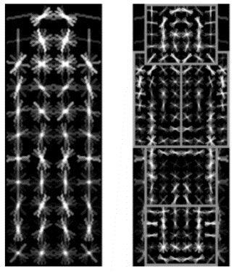
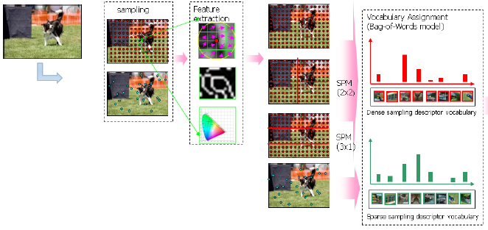

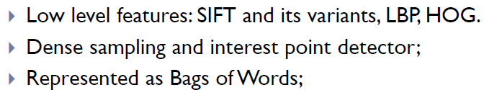
Traditional Recognition Approach
Features are key to recent progress in recognition
Multitude of hand-designed features currently in use
SIFT, HOG, ………….
Where next? Better classifiers? Or keep building more features?
Felzenszwalb, Girshick, McAllester and Ramanan, PAMI 2007
Yan & Huang (Winner of PASCAL 2010 classification competition)

Slide 5
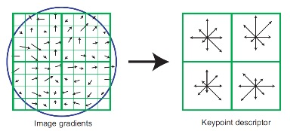
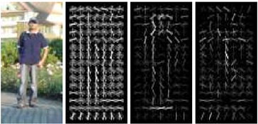
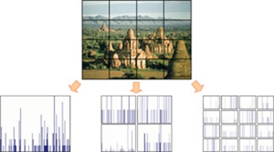
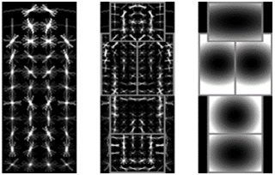
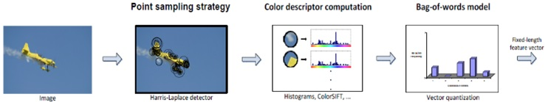
Features are key to recent progress in recognition
SIFT [Loewe IJCV 04]
HOG [Dalal and Triggs CVPR 05]
SPM [Lazebnik et al. CVPR 06]
DPM [Felzenszwalb et al. PAMI 10]
Color Descriptor [Van De Sande et al. PAMI 10]

Slide 6
What about learning the features?
Learn a feature hierarchy all the way from pixels to classifier
Each layer extracts features from the output of previous layer
Layers have (nearly) the same structure
Train all layers jointly
Image/ Video
Pixels
Layer 1
Layer 2
Layer 3
Simple Classifier
Notes:
Make clear that classic methods, e.g. convnets are purely supervised.

Slide 7
“Shallow” vs. “deep” architectures
Traditional recognition: “Shallow” architecture
Image/ Video
Pixels
Hand-designed feature extraction
Trainable classifier
Object Class
Deep learning: “Deep” architecture
Image/ Video
Pixels
Layer 1
Layer N
Simple classifier
…
Object Class

Slide 8
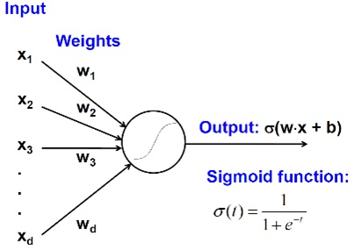
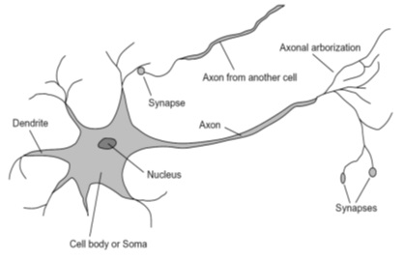
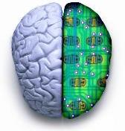
Biological neuron and Perceptrons
A biological neuron
An artificial neuron (Perceptron)
- a linear classifier
Notes:
At the majority of synapses, signals are sent from the axon of one neuron to a dendrite of another... All neurons are electrically excitable, maintaining voltage gradients across their membranes… If the voltage changes by a large enough amount, an all-or-none electrochemical pulse called an action potential is generated, which travels rapidly along the cell's axon, and activates synaptic connections with other cells when it arrives.

Slide 9
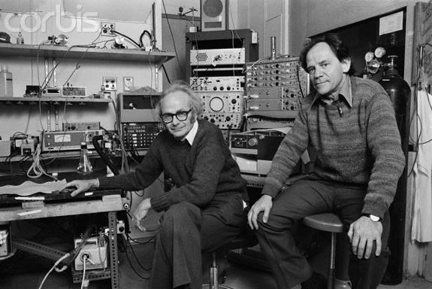
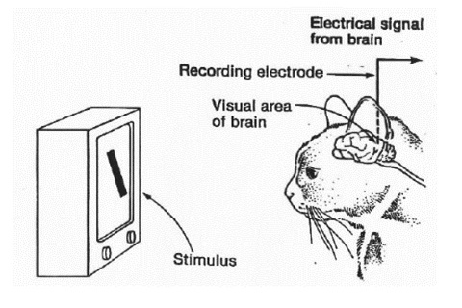
Simple, Complex and Hyper-complex cells
video
David H. Hubel and Torsten Wiesel
Suggested a hierarchy of feature detectors in the visual cortex, with higher level features responding to patterns of activation in lower level cells, and propagating activation upwards to still higher level cells.
David Hubel's Eye, Brain, and Vision
Notes:
D. Hubel and T. Wiesel (1959, 1962, Nobel Prize 1981)
Visual cortex consists of a hierarchy of simple, complex, and hyper-complex cells
In one experiment, done in 1959, they inserted a microelectrode into the primary visual cortex of an anesthetized cat. They then projected patterns of light and dark on a screen in front of the cat.

Slide 10
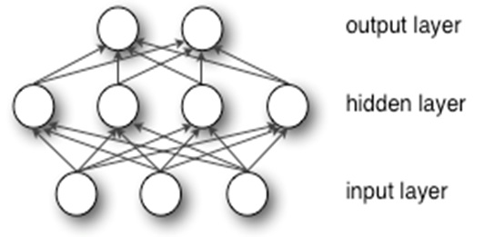
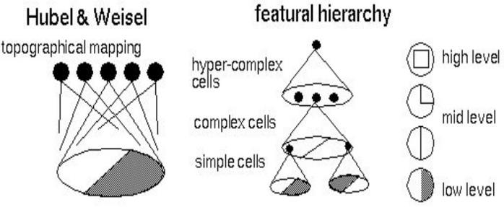
Hubel/Wiesel Architecture and Multi-layer Neural Network
Hubel and Weisel’s architecture
Multi-layer Neural Network
- A non-linear classifier
Notes:
simple cells: neurons that fire rapidly when presented with lines at one angle (orientation-sensitive). Respond to light patterns and dark patterns differently. Found all over the visual cortex.
with excitatory and inhibitory regions (represented by white and gray regions)
complex cells: detect edges regardless of where they were placed in the receptive field of the neuron and could preferentially detect motion in certain directions.
respond in a contrast-insensitive manner, i.e. the same cell might respond to a dark/light edge and a light/dark edge but only if it were at the proper orientation. Furthermore, the complex cells would respond to their edges in a larger region of the visual field. This suggested that complex cells received input from lower level simple cells by way of a receptive field.
"hypercomplex" cells: respond to more complex combinations of the simple features, for example to two edges at right angles to each other in a yet larger region of the visual field.
These studies showed how the visual system constructs complex representations of visual information from simple stimulus features.

Slide 11
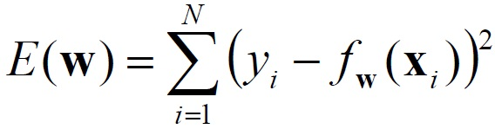
Multi-layer Neural Network
A non-linear classifier
Training: find network weights w to minimize the error between true training labels and estimated labels
Minimization can be done by gradient descent provided f is differentiable
This training method is called back-propagation

Slide 12
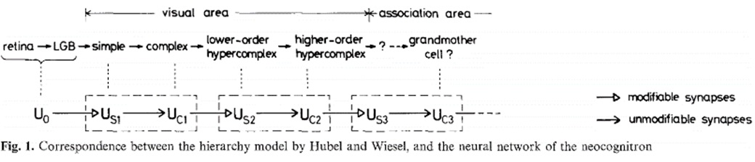
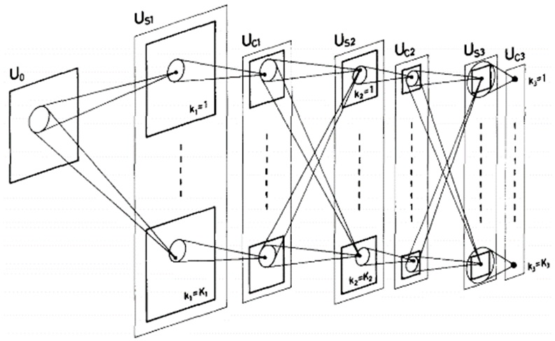
Neocognitron [Fukushima, Biological Cybernetics 1980]
Deformation-Resistant Recognition
S-cells: (simple)
- extract local features
C-cells: (complex)
- allow for positional errors
Notes:
hierarchical, multilayered artificial neural network inspired by the model proposed by Hubel & Wiesel in 1959
The neocognitron is a natural extension of these cascading models. The neocognitron consists of multiple types of cells, the most important of which are called S-cells and C-cells.[2] The local features are extracted by S-cells, and these features' deformation, such as local shifts, are tolerated by C-cells. Local features in the input are integrated gradually and classified in the higher layers.[3] The idea of local feature integration is in several other models, such as LeNet and SIFT model.

Slide 13
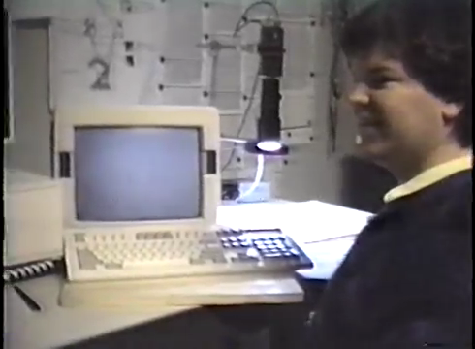
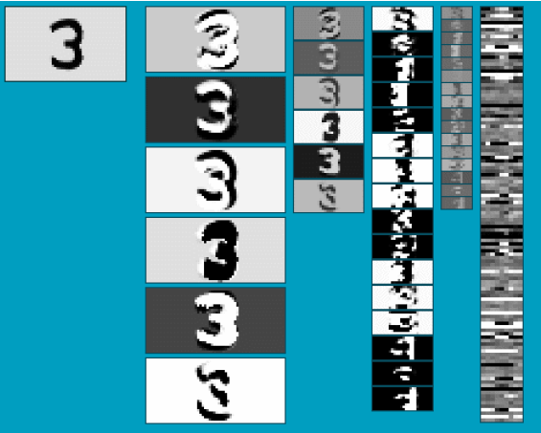
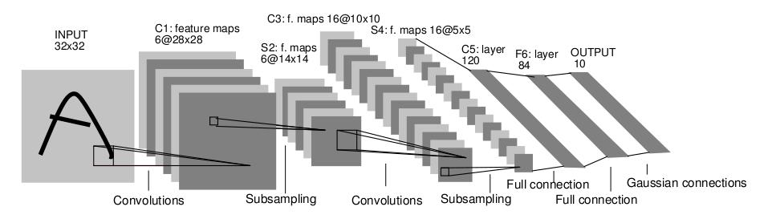
Convolutional Neural Networks (CNN, Convnet)
Multi-layer Neural network with
Local connectivity
Shared weight parameters across spatial positions
Stack multiple stages of feature extractors
Higher stages compute more global, more invariant features
Classification layer at the end
LeNet-1 from 1993
Y. LeCun, L. Bottou, Y. Bengio, and P. Haffner, Gradient-based learning applied to document recognition, Proceedings of the IEEE 86(11): 2278–2324, 1998.

Slide 14
Convolutional Neural Networks (CNN, Convnet)
Feed-forward feature extraction:
Convolve input with learned filters
Non-linearity
Spatial pooling
Normalization
Supervised training of convolutional filters by back-propagating classification error
Feature maps
Normalization
Spatial pooling
Non-linearity
Convolution (Learned)
Input Image

Slide 15
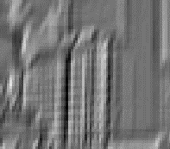
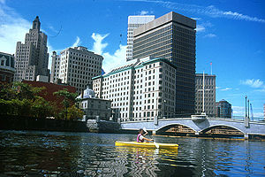
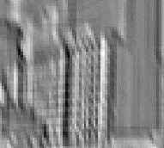


1. Convolution
Dependencies are local
Translation invariance
Few parameters (filter weights)
Stride can be greater than 1 (faster, less memory)
...
Input
Feature Map
Notes:
connect each neuron to only a local region of the input volume.

Slide 16
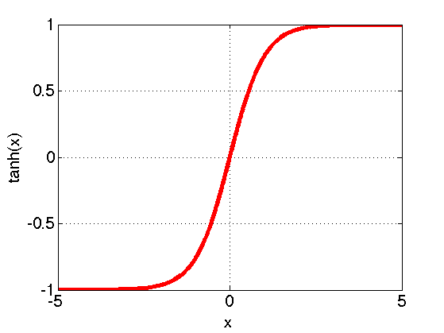
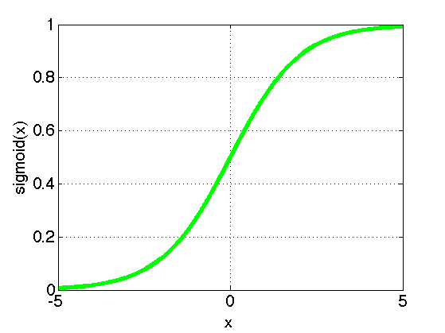
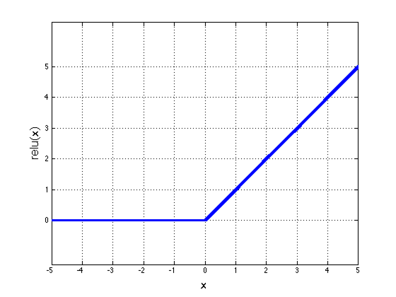
2. Non-Linearity
Per-element (independent)
Options:
Tanh
Sigmoid: 1/(1+exp(-x))
Rectified linear unit (ReLU)
Simplifies backpropagation
Makes learning faster
Avoids saturation issues → Preferred option

Slide 17

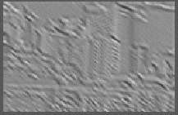

3. Spatial Pooling
Sum or max
Non-overlapping / overlapping regions
Role of pooling:
Invariance to small transformations
Larger receptive fields (see more of input)
Max
Sum
Notes:
Translation invariance

Slide 18
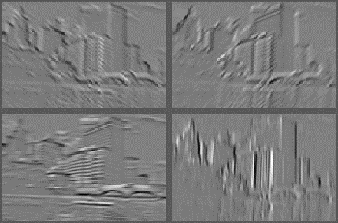
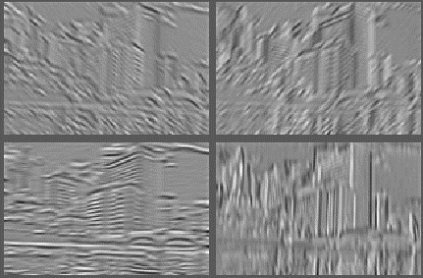
4. Normalization
Within or across feature maps
Before or after spatial pooling
Feature Maps After Contrast Normalization
Feature Maps

Slide 19
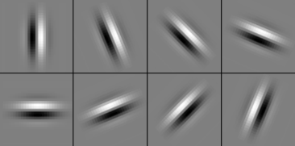
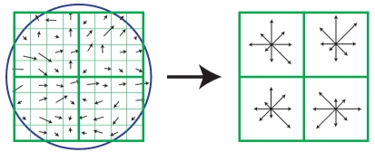
Compare: SIFT Descriptor
Lowe [IJCV 2004]
Image Pixels
Apply oriented filters
Spatial pool
(Sum)
Feature Vector
Normalize to unit length

Slide 20
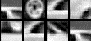
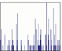
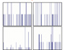
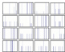
Compare: Spatial Pyramid Matching
Lazebnik, Schmid, Ponce [CVPR 2006]
SIFT features
Filter with Visual Words
Take max VW response
Multi-scale spatial pool
(Sum)
Global image descriptor

Slide 21
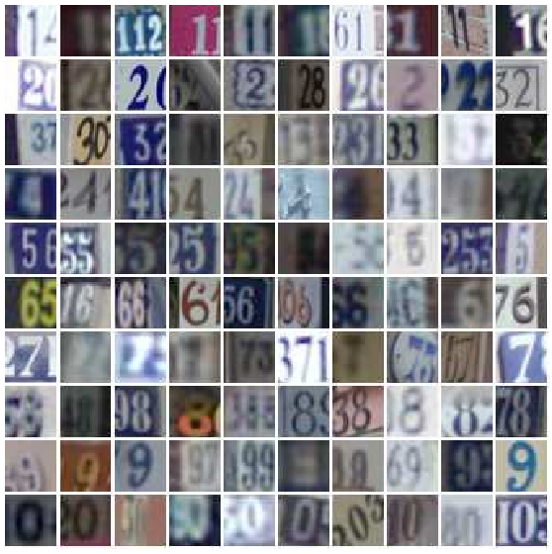
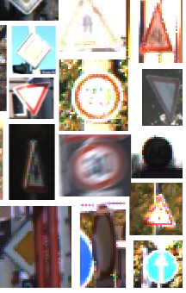
Convnet Successes
Handwritten text/digits
MNIST (0.17% error [Ciresan et al. 2011])
Arabic & Chinese [Ciresan et al. 2012]
Simpler recognition benchmarks
CIFAR-10 (9.3% error [Wan et al. 2013])
Traffic sign recognition
0.56% error vs 1.16% for humans [Ciresan et al. 2011]
But until recently, less good at more complex datasets
Caltech-101/256 (few training examples)

Slide 22
ImageNet Challenge 2012
~14 million labeled images, 20k classes
Images gathered from Internet
Human labels via Amazon Turk
ImageNet Challenge: 1.2 million training images, 1000 classes
[Deng et al. CVPR 2009]
A. Krizhevsky, I. Sutskever, and G. Hinton, ImageNet Classification with Deep Convolutional Neural Networks, NIPS 2012

Slide 23
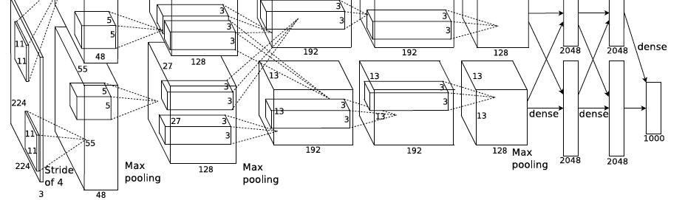
ImageNet Challenge 2012
“AlexNet”: Similar framework to LeCun’98 but:
Bigger model (7 hidden layers, 650,000 units, 60,000,000 params)
More data (10⁶ vs. 10³ images)
GPU implementation (50x speedup over CPU)
Trained on two GPUs for a week
Better regularization for training (DropOut)
A. Krizhevsky, I. Sutskever, and G. Hinton, ImageNet Classification with Deep Convolutional Neural Networks, NIPS 2012
Notes:
Two-GPU architecture

Slide 24
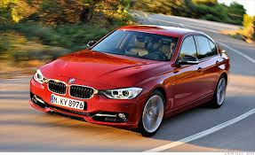
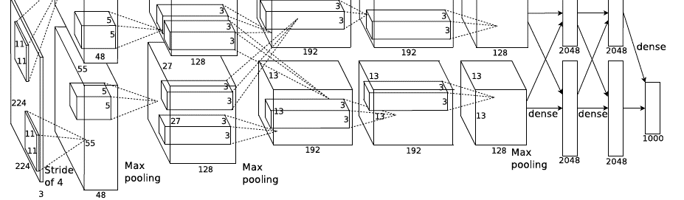
Using CNN for Image Classification
AlexNet
“car”
Fixed input size: 224x224x3

Slide 25
ImageNet Challenge 2012
Krizhevsky et al. -- 16.4% error (top-5)
Next best (non-convnet) – 26.2% error

Slide 26
ImageNet Challenge 2012-2014
Best non-convnet in 2012: 26.2%
Team | Year | Place | Error (top-5) | External data
SuperVision – Toronto (7 layers) | 2012 | - | 16.4% | no
SuperVision | 2012 | 1st | 15.3% | ImageNet 22k
Clarifai – NYU (7 layers) | 2013 | - | 11.7% | no
Clarifai | 2013 | 1st | 11.2% | ImageNet 22k
VGG – Oxford (16 layers) | 2014 | 2nd | 7.32% | no
GoogLeNet (19 layers) | 2014 | 1st | 6.67% | no
Human expert* |  |  | 5.1%
Team | Method | Error (top-5)
DeepImage - Baidu | Data augmentation + multi GPU | 5.33%
PReLU-nets - MSRA | Parametric ReLU + smart initialization | 4.94%
BN-Inception ensemble - Google | Reducing internal covariate shift | 4.82%
Notes:
Best non-convnet in 2012: 26.2%

Slide 27
Understanding and Visualizing CNN
Visualize input pattern using deconvnet
Individual neuron activation
Fooling CNNs

Slide 28
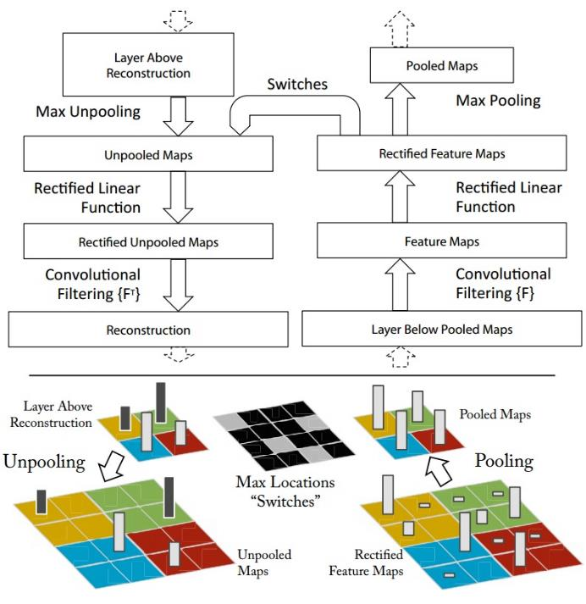
Map activation back to the input pixel space
What input pattern originally caused a given activation in the feature maps?
Visualizing and Understanding Convolutional Networks [Zeiler and Fergus, ECCV 2014]

Slide 29
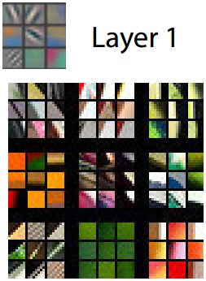
Layer 1
Visualizing and Understanding Convolutional Networks [Zeiler and Fergus, ECCV 2014]
Notes:
Patches from validation images that give maximal activation of a given feature map

Slide 30
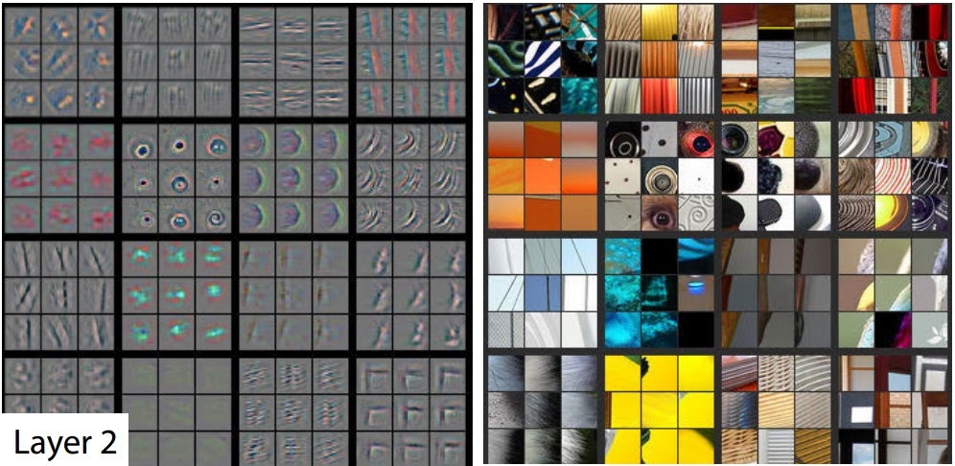
Layer 2
Visualizing and Understanding Convolutional Networks [Zeiler and Fergus, ECCV 2014]

Slide 31
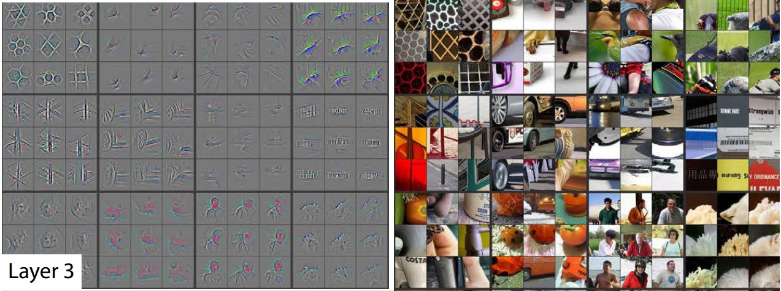
Layer 3
Visualizing and Understanding Convolutional Networks [Zeiler and Fergus, ECCV 2014]

Slide 32
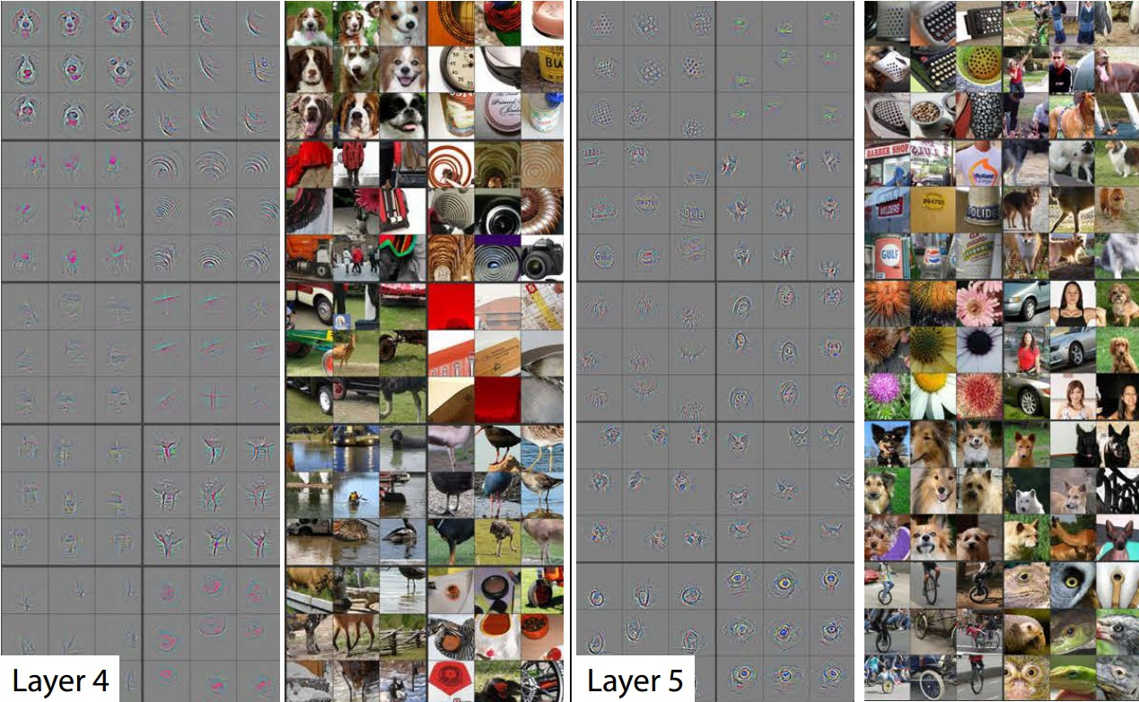
Layer 4 and 5
Visualizing and Understanding Convolutional Networks [Zeiler and Fergus, ECCV 2014]

Slide 33
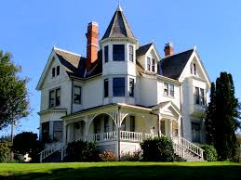
Occlusion Experiment
Mask parts of input with occluding square
Monitor output

Slide 34
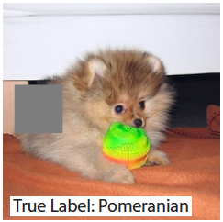
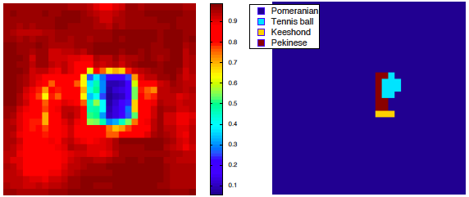
Input image
p(True class)
Most probable class

Slide 35


Input image
p(True class)
Most probable class

Slide 36


Input image
p(True class)
Most probable class

Slide 37

Individual Neuron Activation
RCNN [Girshick et al. CVPR 2014]

Slide 38

Individual Neuron Activation
RCNN [Girshick et al. CVPR 2014]

Slide 39

Individual Neuron Activation
RCNN [Girshick et al. CVPR 2014]

Slide 40

Fooling CNNs
Intriguing properties of neural networks [Szegedy ICLR 2014]

Slide 41

What is going on?
x
Explaining and Harnessing Adversarial Examples [Goodfellow ICLR 2015]
http://karpathy.github.io/2015/03/30/breaking-convnets/

Slide 42
What is going on?
Recall gradient descent training: modify the weights to reduce classifier error
Adversarial examples: modify the image to increase classifier error
Explaining and Harnessing Adversarial Examples [Goodfellow ICLR 2015]
http://karpathy.github.io/2015/03/30/breaking-convnets/

Slide 43

Fooling CNNs
Deep Neural Networks are Easily Fooled: High Confidence Predictions for Unrecognizable Images [Nguyen et al. CVPR 2015]

Slide 44

Images that both CNN and Human can recognize
Deep Neural Networks are Easily Fooled: High Confidence Predictions for Unrecognizable Images [Nguyen et al. CVPR 2015]

Slide 45

Direct Encoding
Deep Neural Networks are Easily Fooled: High Confidence Predictions for Unrecognizable Images [Nguyen et al. CVPR 2015]

Slide 46

Indirect Encoding
Deep Neural Networks are Easily Fooled: High Confidence Predictions for Unrecognizable Images [Nguyen et al. CVPR 2015]

Slide 47
Beyond classification
Detection
Segmentation
Regression
Pose estimation
Matching patches
Synthesis
and many more…

Slide 48

R-CNN: Regions with CNN features
Trained on ImageNet classification
Finetune CNN on PASCAL
RCNN [Girshick et al. CVPR 2014]

Slide 49


Labeling Pixels: Semantic Labels
Fully Convolutional Networks for Semantic Segmentation [Long et al. CVPR 2015]

Slide 50

Labeling Pixels: Edge Detection
DeepEdge: A Multi-Scale Bifurcated Deep Network for Top-Down Contour Detection
[Bertasius et al. CVPR 2015]

Slide 51

CNN for Regression
DeepPose [Toshev and Szegedy CVPR 2014]

Slide 52





CNN as a Similarity Measure for Matching
Stereo matching [Zbontar and LeCun CVPR 2015]
Compare patch [Zagoruyko and Komodakis 2015]
FaceNet [Schroff et al. 2015]
Match ground and aerial images
[Lin et al. CVPR 2015]
FlowNet [Fischer et al 2015]

Slide 53



CNN for Image Restoration/Enhancement
Super-resolution [Dong et al. ECCV 2014]
Non-blind deconvolution [Xu et al. NIPS 2014]
Non-uniform blur estimation [Sun et al. CVPR 2015]

Slide 54

CNN for Image Generation
Learning to Generate Chairs with Convolutional Neural Networks [Dosovitskiy et al. CVPR 2015]

Slide 55

Chair Morphing
Learning to Generate Chairs with Convolutional Neural Networks [Dosovitskiy et al. CVPR 2015]

Slide 56

Transfer Learning
Improvement of learning in a new task through the transfer of knowledge from a related task that has already been learned.
Weight initialization for CNN
Learning and Transferring Mid-Level Image Representations using Convolutional Neural Networks [Oquab et al. CVPR 2014]

Slide 57


Convolutional activation features
[Donahue et al. ICML 2013]
CNN Features off-the-shelf: an Astounding Baseline for Recognition [Razavian et al. 2014]

Slide 58

Timeline for different models

Slide 59

Timeline for different models

Slide 60
CNN packages
Cuda-convnet (A. Krizhevsky, Google)
Caffe (Y. Jia, Berkeley)
Replacement of deprecated Decaf
Overfeat (NYU)
Torch
MatConvNet (A. Vedaldi, Oxford)

Slide 61
Resources
http://deeplearning.net/
https://github.com/ChristosChristofidis/awesome-deep-learning
http://cs231n.stanford.edu/syllabus.html

